Slide 1
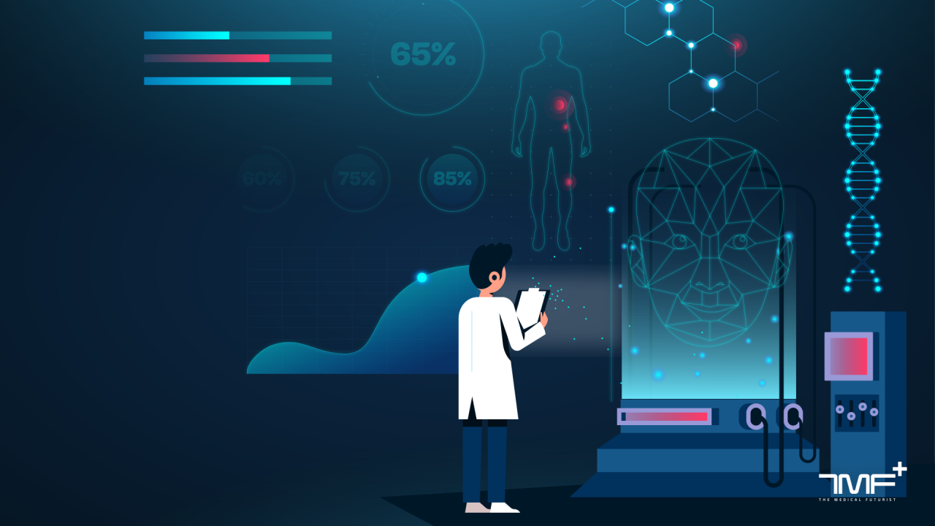
Multi-Agent Healthcare Assistant
AI-Powered Clinical Triage & E-Pharmacy Integration POC
By
Vidisha Arvind
Associate Data Scientist | Technical Presentation

Slide 2
1. Problem Statement & Scope
People often struggle to understand symptoms, reports, or what action to take next despite abundant medical information online.
To support early decision-making, we built an AI-driven multi-agent healthcare assistant that guides users from symptom intake to OTC suggestions and pharmacy access.
System Scope
✔ End-to-end pipeline: Intake → Imaging → Therapy → Pharmacy ✔ Accepts: X-ray images, PDF reports, symptom notes, patient details ✔ Outputs: OTC recommendations, risk flags, pharmacy availability + ETA ✔ Safety-first: age checks, allergy filter, drug interaction alerts, red-flag escalation
⚠️ Safety Constraints: Educational demo only • No prescriptions • PII/PHI masked • Prominent disclaimers • Red-flag routing to medical professionals

Slide 3
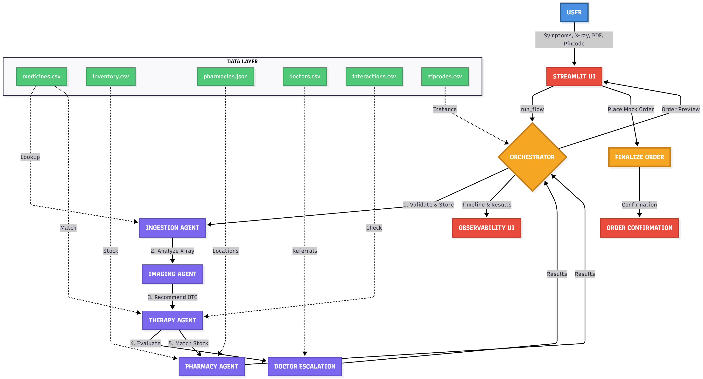
2. System Architecture & Agent Roles
[INSERT ARCHITECTURE DIAGRAM HERE]
Core Agents: Ingestion (file validation, PII masking) • Imaging (X-ray classification) • Therapy (OTC recommendation, interaction screening) • Doctor Escalation (triage logic) • Pharmacy Match (geo + stock) • Orchestrator (flow coordination, timeline tracking)

Slide 4
3. Data Mocks & Assumptions
No real medical data used -> all datasets are synthetic & POC-focused
X-ray imaging is mock-classified using filename cues & random probabilities i.e no real diagnostic model
Symptoms → Condition → Recommendation logic is rule-based, not clinical grade
Distance, ETA & delivery fee calculated using dummy heuristics
Output suggestions are not medical advice as system only provides OTC guidance, not prescriptions

Slide 5
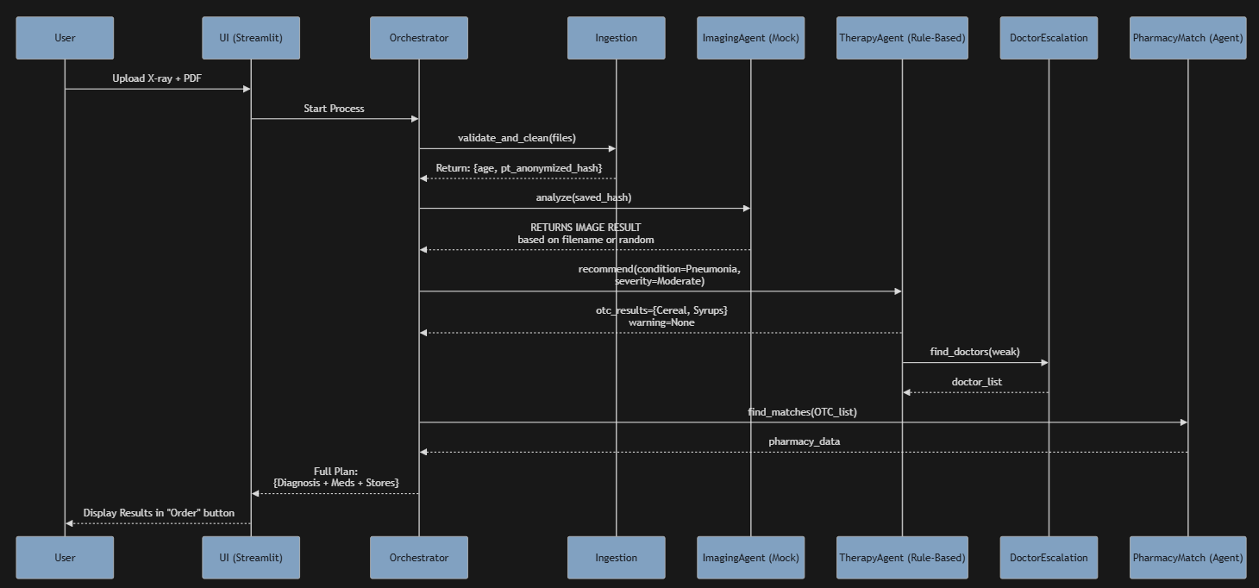
4. Demo Journey: User Flow

Slide 6
5. Safety Mechanisms: Risks, Red-Flags & Escalation
• OTC only: No prescription drugs recommended
• PII/PHI protection: Names and phone numbers masked in logs; file names anonymized (e.g., xray_abc123.jpg)
• Prominent disclaimers: 'Educational demo only, not medical advice' shown throughout UI
• Age & allergy screening: Automatic contraindication checks before any recommendation
• Interaction warnings: High/Moderate drug-drug interactions flagged to user
• Limitations: Mock X-ray classifier (filename heuristics), no real medical diagnosis, dummy pharmacy geo/stock data
Assistive, not diagnostic — user safety & caution first.

Slide 7
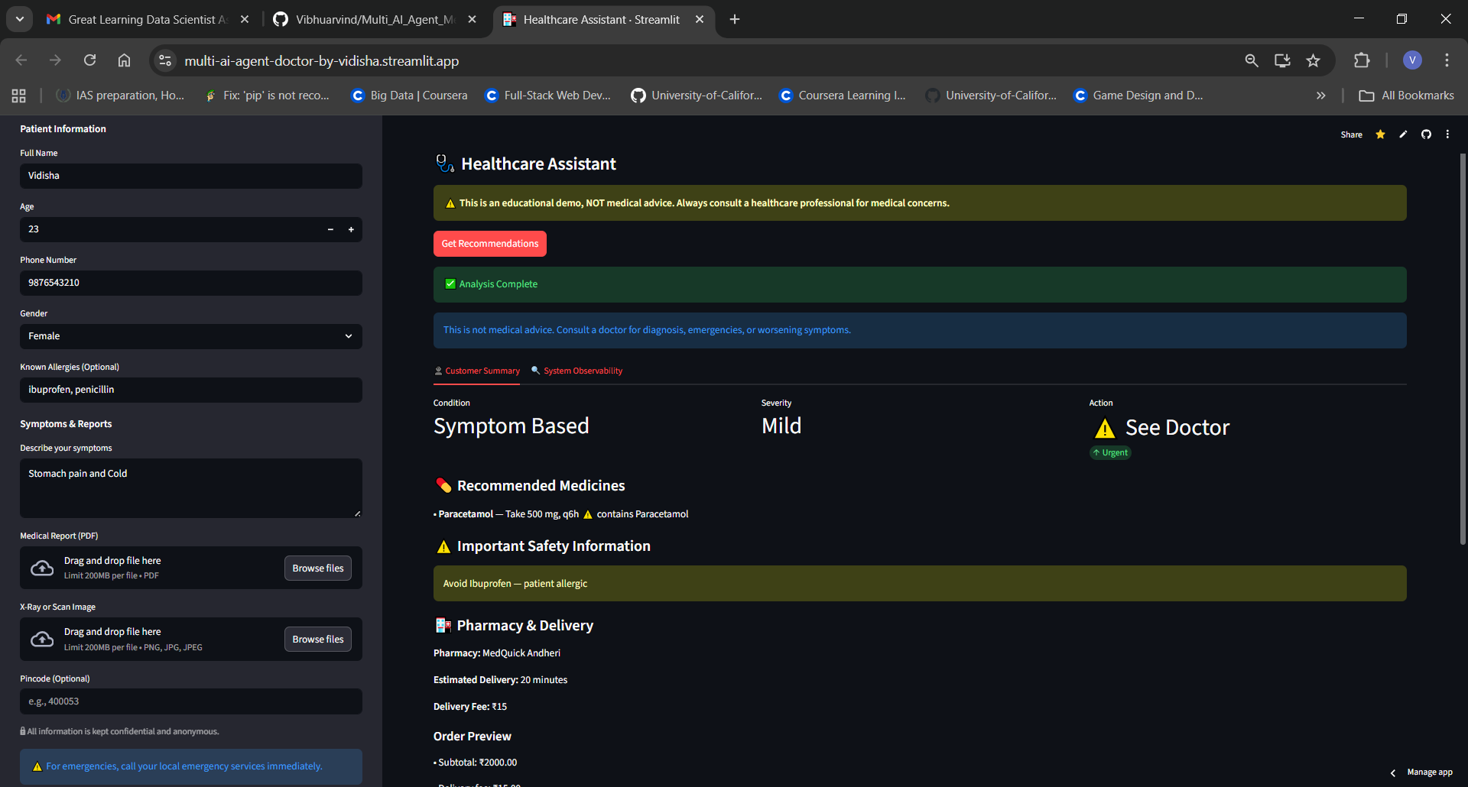
6. Deployment, Logs & Known Limitations
App is deployed at: https://multi-ai-agent-doctor-by-vidisha.streamlit.app/
⚠️ Known Limitations
Mock ML + rule-based logic (no real CNN/OCR; static CSV data instead of live APIs)
Simplified pharmacy & geo calculations (dummy distance/ETA, no payments or authentication)
Not Scalable — no multi-user support, or real ordering system.

Slide 8
7. Next Steps (Given 2 More Weeks)
Upgrade imaging with real pretrained X-ray model
Add RAG medical knowledge + voice (STT/TTS)
Backend shift to FastAPI + DB + login & user history
Integrate Practo/Pharmacy APIs for real doctor & medicine availability
Geo-based nearest pharmacy suggestions using real maps API
CI/CD deployment + optional LLM orchestration & monitoring

Slide 9

Thank You
Questions & Discussion
Multi-Agent Healthcare Assistant POC
Demo: [https://multi-ai-agent-doctor-by-vidisha.streamlit.app/]
• GitHub: [https://github.com/Vibhuarvind/Multi_AI_Agent_Medical_Assistant/]

